Slide 1
Infosys Springboard Internship Hate Speech Detection in Twitter Platform
Harsha K

Slide 2
Business Problem
In today's digital age, hate speech on online platforms is a growing concern that impacts individuals and communities globally. Social media sites like Twitter, hosting billions of users generating vast content daily, face significant challenges due to the prevalence of hate speech. These challenges include psychological harm to individuals, social unrest through incitement of violence and discrimination, legal risks from failing to manage hate speech, and damage to the platform’s brand reputation.

Slide 3
Solution
To address hate speech on Twitter, we propose a machine learning and deep learning model to automatically detect and categorize content.
Data Collection: Gather a diverse and comprehensive dataset of user-generated content from Twitter.
Data Preprocessing: Clean and preprocess the data to ensure it is suitable for training the model.
Model Training: Train a robust machine learning and deep learning model using the preprocessed dataset.
Evaluation: Test and validate the model to ensure high accuracy and reliability in detecting hate speech.

Slide 4
Dataset Description
The dataset has over 24,000 entries covering hate speech scenarios on Twitter. Quality is ensured through rigorous annotation by diverse annotators. It enhances user experience and engagement while reducing legal risks. Each tweet is labeled as hate speech, offensive language, or neutral. The structure includes tweet count, presence of hate speech, offensive language, neutrality, categorization (0 = hate speech, 1 = offensive language, 2 = neutral), and the tweet text.
Class | Tweets
0 | " So hoes that smoke are losers ? " yea ... go on IG
0 | "@Dietrich1892: Yall shut up:p" make me bitch
1 | !!! RT @mayasolovely: As a woman you shouldn't complain about cleaning up your house. &amp; as a man you should always take the trash out…

Slide 5
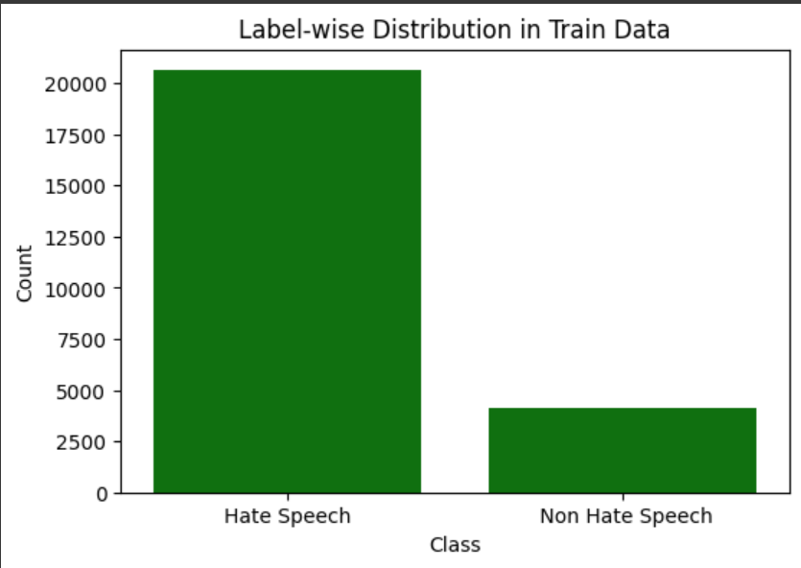
Data Distribution
Label-wise counts in Data:
Hate speech -20609
Non Hate speech- 4159

Slide 6
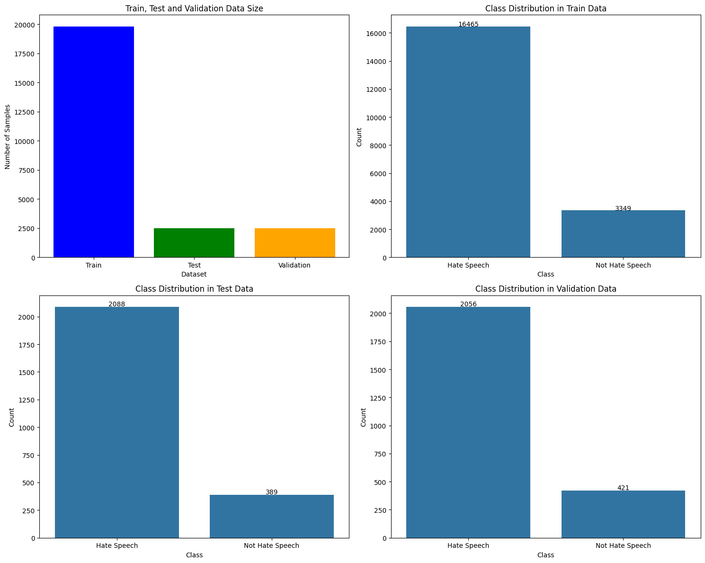
Train, Test and Validation

Slide 7
Data Preprocessing
Data preprocessing prepares raw data for a model and is the first crucial step in the process. The steps included are:
Recategorization: Label hate speech and offensive language as 0, non-hate speech as 1.
Handling abbreviations: Replace with full forms.
HTML entity decoding: Decode HTML entities.
Contraction expansion: Expand contractions.
Normalization: Apply normalization to the data.

Slide 8
Tokenization and Embedding Techniques
Tokenization
Word tokenization involves dividing text into individual words, treating each word as a fundamental unit of meaning.
Embedding Techniques
One-Hot Encoding: Converts categorical values into binary vectors where each category is represented by a column with values 1 or 0.
TF-IDF Encoding: Reflects the importance of words in documents by considering both their frequency in a document (TF) and their rarity across the entire corpus (IDF).
Word2Vec Encoding: Builds distributed numerical representations of words, capturing semantic relationships and contextual meanings within the vocabulary.

Slide 9
Modeling
Machine Learning Model
Random Forest Model
Naive Bayes Model
Deep Learning Models
Artificial Neural Network (ANN)
Convolutional Neural Networks (CNN)
Long short-term memory (LSTM)

Slide 10
Finalized Deep Learning Model
Artificial Neural Network
Ability to learn complex patterns.
Handle large-scale data effectively.
Achieve state-of-the-art performance in various domains, and support end-to-end learning.
These characteristics make them particularly suitable for tasks where traditional machine learning approaches may struggle.

Slide 11
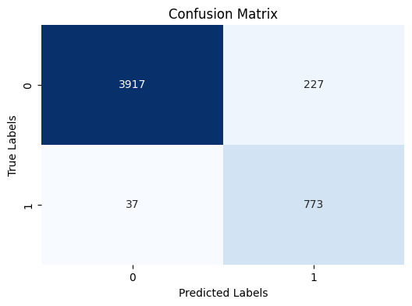
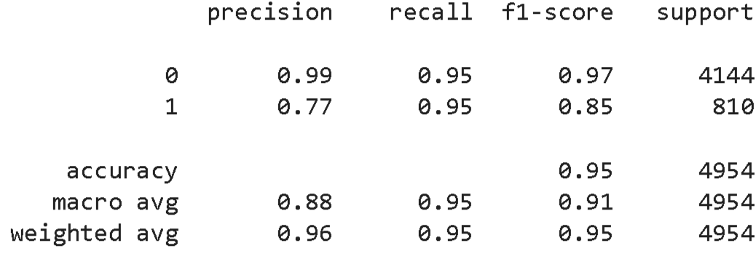
Classification Report and Confusion Matrix

Slide 12
Evaluation Metrics
Key Matrix for Evaluation: F1 Score
The F1 score is the harmonic mean of precision and recall, providing a single metric to assess the balance between the two.
Why F1 Score Over Other Parameters
Balance of Precision and Recall: F1 score strikes a balance between precision and recall, crucial for tasks like hate speech detection where both false positives and false negatives matter.
Suitability for Imbalanced Datasets: It equally penalizes errors in rare instances like hate speech in Twitter datasets, offering a fair evaluation across different classes.
F1 Scores Achieved Using Artificial Neural Network
Class 0: 0.97
Class 1: 0.85

